Slide 1



Slide 2

SMART COVID TREATMENT
Project By :-
Uttam Keshri
Ashish Kumar
Sambhavi Rai
Faculty :-
Dr. Suganya G
(Associate Professor, SCOPE)

Slide 3




Slide 4


Designed Modules
Schema
Virtual Medical Assistant
1
Heart Rate Monitoring
3
5
Using Web-Cam from skin color variation caused by blood circulation
AI – Based Automated HealthCare Chatbot
Covid-19 Detection
Fever Detection
Smart Covid Hospital
Smart –Xray (+CT) –Scan Based – Covid-19 Virus Detector
2
Using LM35 temperature IoT Device Sensor.
4
Web Portal - Hospital Management System

Slide 5
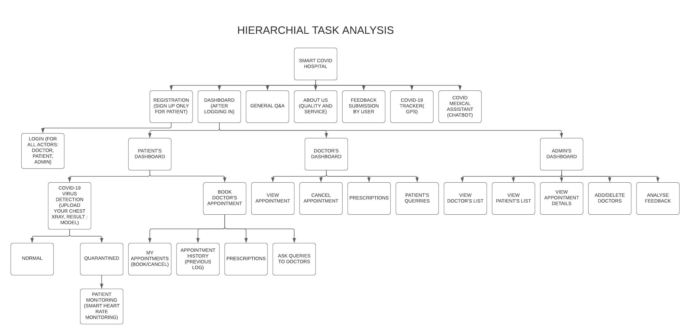

Slide 6
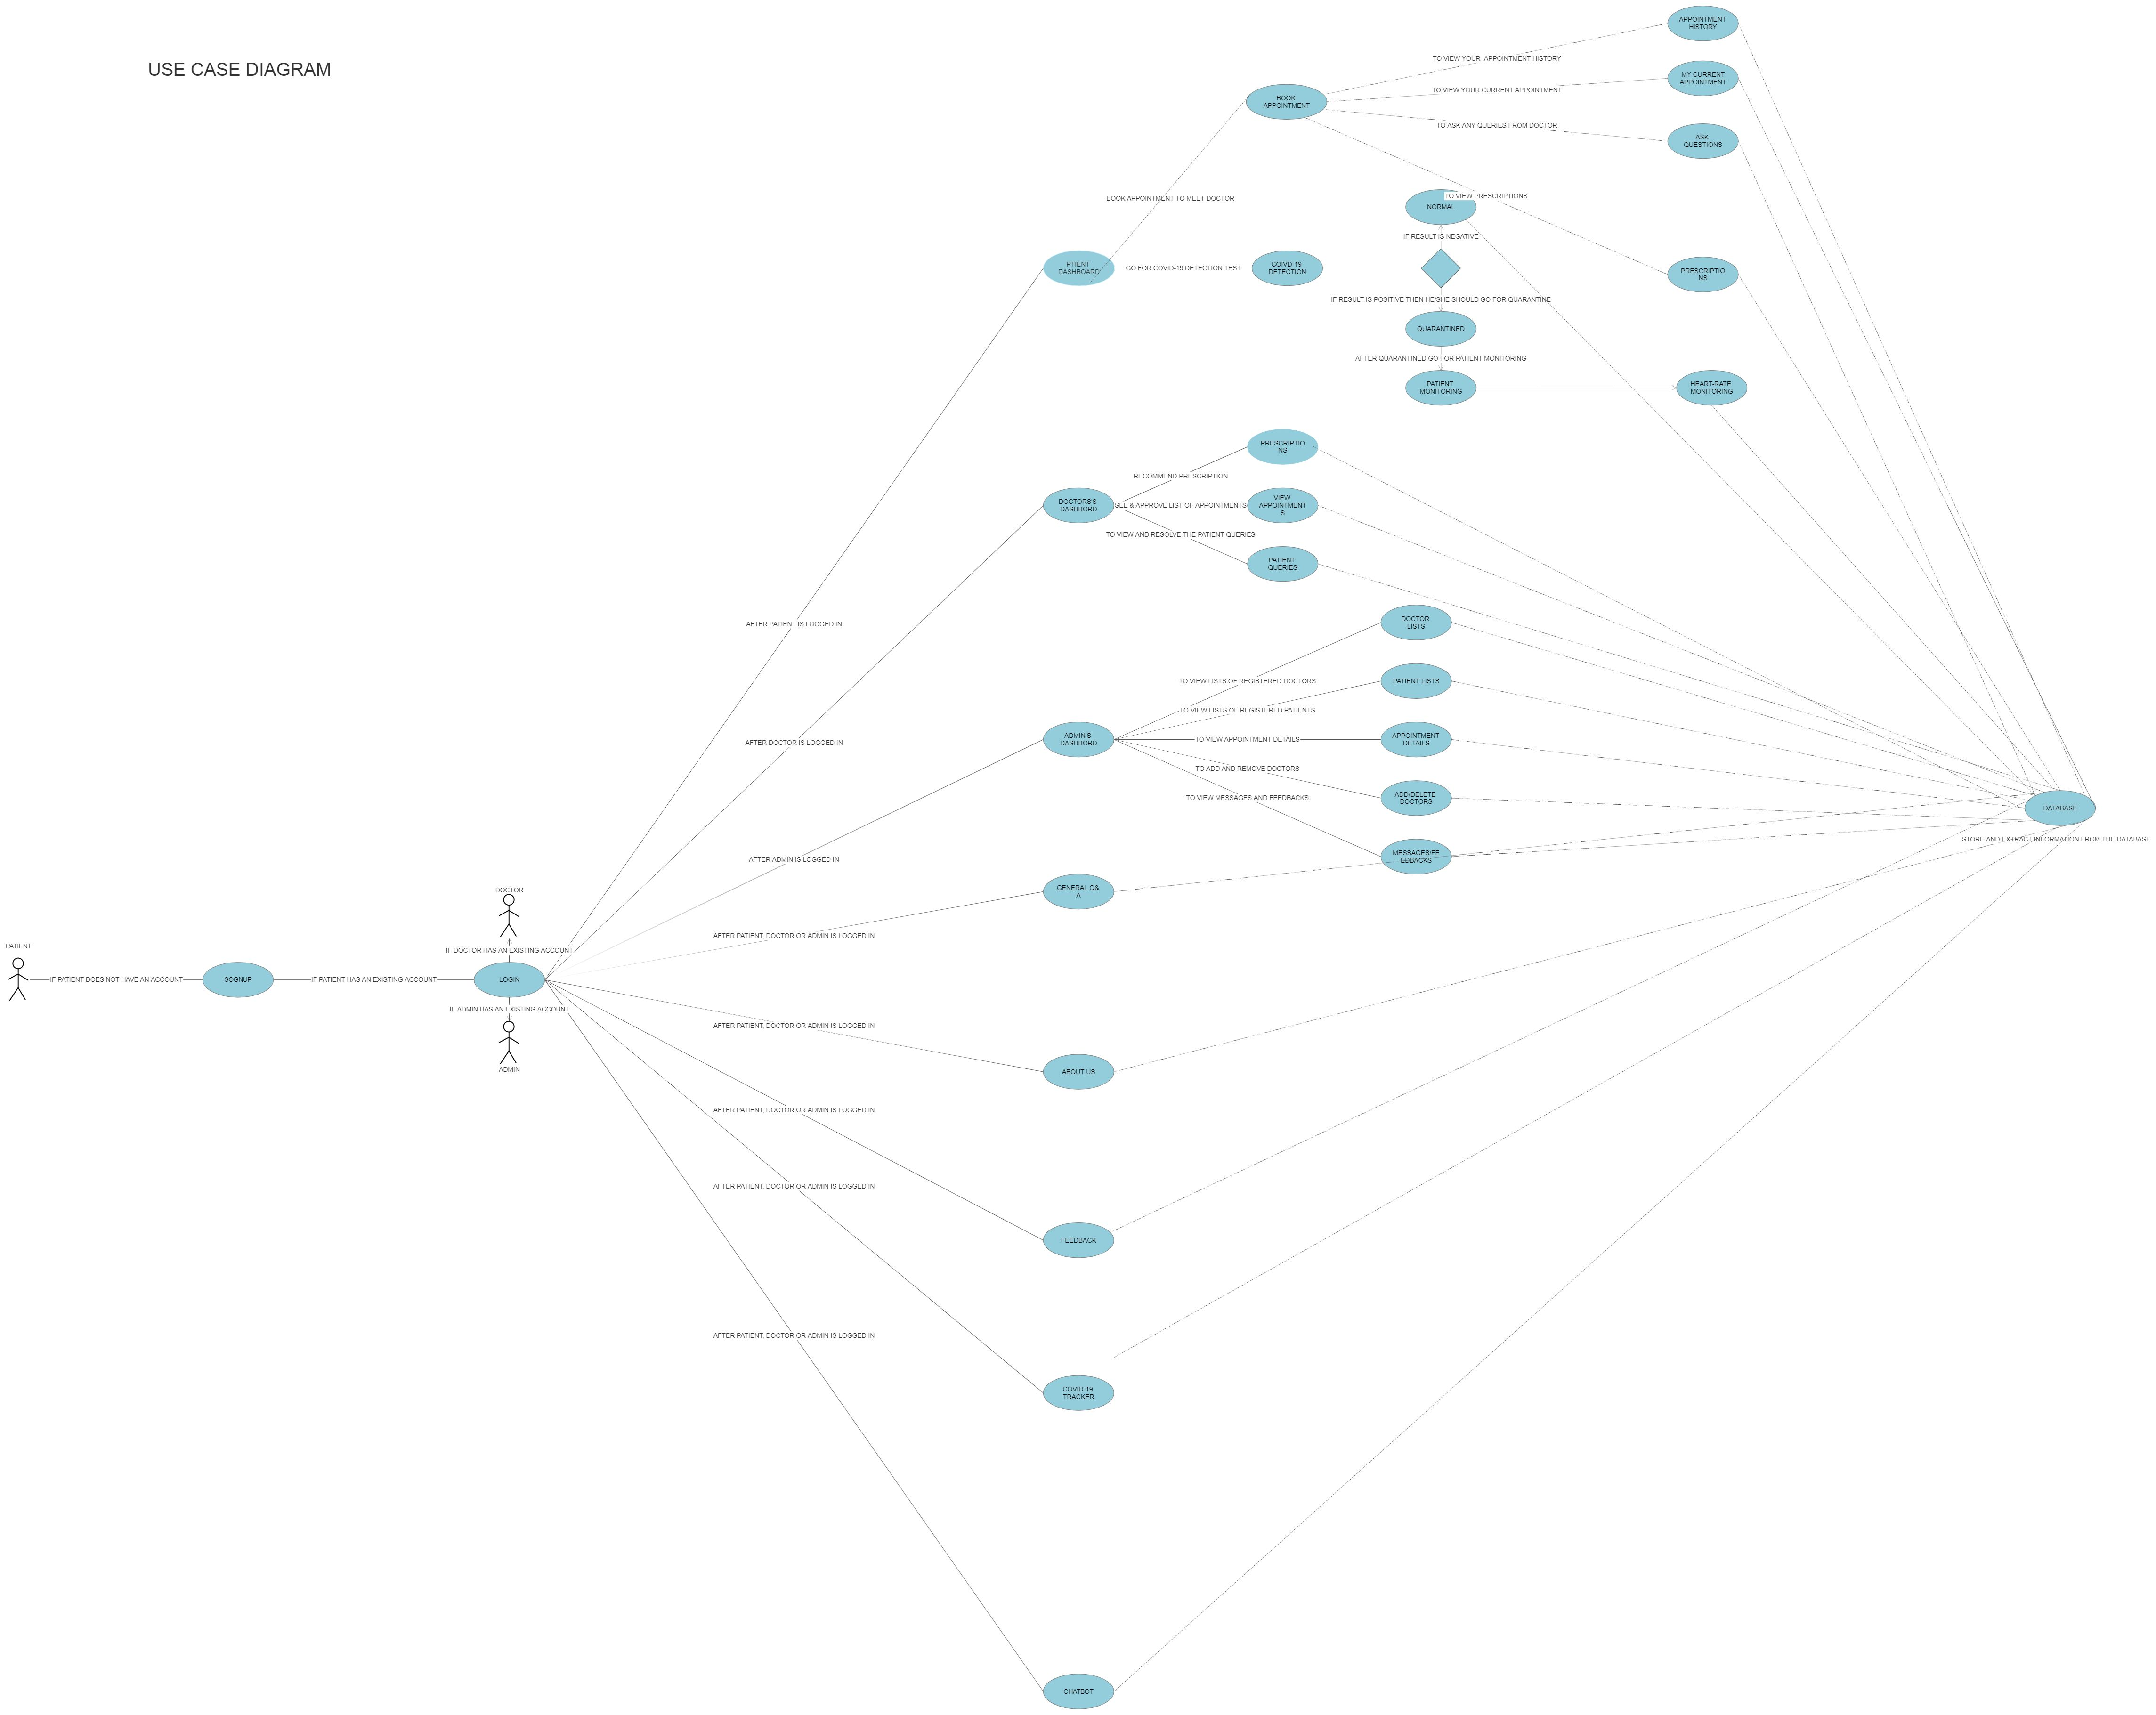

Slide 7
The aim was to develop a quick way to detect the nCov 2019 (Coronavirus 2019/2020, also called disease: "Covid-19" stemming from virus: "SARS-CoV-2") strain, and as such artificial neural networks were used to develop systems in line with the initial aim.
Project : SMART-CORONA_VIRUS_DETECTOR. This Xray-scan version (also the image analysis/Artificial Intelligence based nCov/Covid19 diagnosis code).
This can also reasonably allow for less experienced medical personnel to make preliminary diagnoses, expanding the diagnosis efforts overall. This effort may contribute towards virus-control progress, together with other ai based endeavours being developed across the globe, such as use of ai for vaccine development.
This convolutional neural network architecture can reasonably also be trained on CT-Scan image data (that many Covid19 papers seem to concern), separate from the Xray data (from the non-Covid19 Pneumonia Kaggle Process) upon which training occurred, initially, apart from the latest Covid19 training sequence on Covid19 data.
Countries with aggressive/thorough testing, seem to face lower mortality rates (eg South Korea, <1% mortality rate) versus countries with terrible/barely existent testing/screening, (eg USA >3.5% mortality rate, close to the global mortality rate of ~3.4%). This project serves to contribute to extensive testing efforts, to help minimize potentially exponential spread in newly affected regions, and otherwise aid in control even after wide-spread.
An optimal path is reasonably that the (~70% accurate) CDC standard polymerase method, and the (~75% to ~90% accurate) Artificial Intelligence based Xray method are used in concert.
SMART-XRAY (+CT) -SCAN_BASED-
COVID19_VIRUS_DETECTOR
01
02
03
04

Slide 8
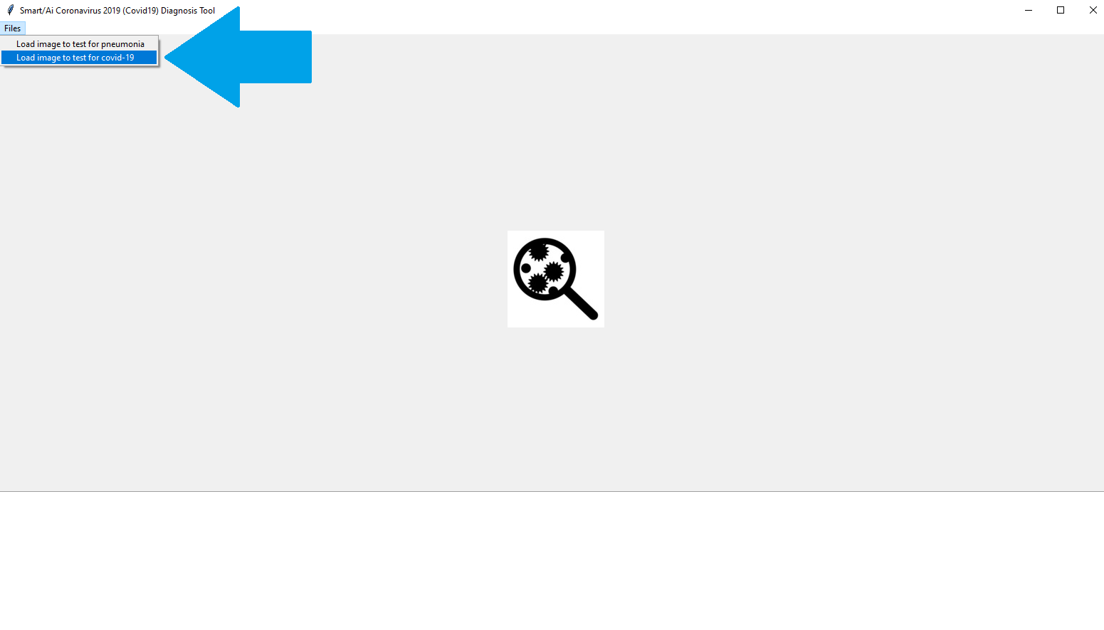
NON-COVID19 PNEUMONIA AND
COVID19 PNEUMONIA DETECTION
We have updated this system such that it does both non-covid19 pneumonia detection and covid19 pneumonia detection, using separate convolutional neural network models, via two different droplist options seen below:
This seeks to increase the robustness of the predictions made by the system.
On the task of Covid19 detection, so far, with the very limited data available, Sensitivity/Specificity/Accuracy are ~85%/~70%/~77% respectively, (where the model has been trained on a covid19 dataset I organized).
For the task of non-Covid19 pneumonia detection, the code base has: Sensitivity/Specificity/Accuracy of ~89%/~88%/~89% respectively.

Slide 9

Molecular and Serology Tests: Up to 2 days before testing is verified.
Xray Image Scan + Artificial Intelligence Diagnosis: ~5 minutes (for scan) + A few milliseconds for Ai diagnosis = ~6 minutes total time for diagnosis result including possible image processing.
WHY?
The nCov 2019 (Coronavirus Strain 2019/2020) is spreading rapidly, with a mortality rate between 2% and 4%.
By comparison, the common flu with a far lower mortality rate of .1%, kills 291,000 to 646,000 per year.
Things get worse; nCov spreads at ~triple the transmission rate of the common flu.
Common flu RO = 1.28 (Estimated, transmission rate)
nCov RO = 2.5 to 3.8 (Estimated transmission rate)
Recent nCov RO estimate ~4.08!
Recent nCov 2019/Covid19 incubation period is estimated at 24 days, and a Chinese woman was recently struck down with symptoms after probation period of 15 days according to the sun newspaper!
Current diagnosis methods may miss the presence of the virus due to faulty DNA based comparison methods, where multiple negative test results may occur before positive results are gained. In addition, more doctors (or rather more automated diagnosis methods) can improve identification rates of the virus.
This ai driven method will reasonably help to stop the exponential growth of the nCov strain.
1 more month of exponential nCov growth = ~ 115 million cases, (of which ~ 23 million are potentially life-threatening ones) according to an epidemiologist/PhD pathologist.
Xray Test Result Time v/s DNA Method (Comparison)

Slide 10
Code
Covid-19/Coronavirus2019/nCov share many similarities with pneumonia. In fact, the time course evolution of a specific strain of covid-19 pneumonia is studied here.
There are already existent pneumonia deep learning platforms, including Kaggle contents rife with deep learning kernels/solutions, pertaining to pneumonia detection.
A pretrained neural network is chosen from google, pertaining to. Pretrained model usage is a way to avoid training on the 2 gigabytes of pneumonia/non-pneumonia training set.
Covid-19 positive Xray scans are taken from various covid19 papers, such as of recent covid-19 paper mentioned in the Data Section.
Preliminary Conclusion
This will reasonably work on potential mild-covid-19 pneumonia patients, within ~0 to 4 days of infection, with "repeated pulmonary CTs", where positive findings of pneumonia associated abnormalities are discoverable.
This will likely work better for patients after ~5 days of infection of covid-19, as abnormalities become distributed across the lungs, where initial CT scans could better discover the Covid-19 markers.
DEEP LEARNING CODE/TESTS + CODE DISCUSSION

Slide 11
DATA
Images from recent covid-19 study: "Emerging Coronavirus 2019-nCoV Pneumonia“.
(https://pubs.rsna.org/doi/full/10.1148/radiol.2020200274)
2.Images from recent covid-19 study: "Imaging Profile of the COVID-19 Infection: Radiologic Findings and Literature Review"
(https://pubs.rsna.org/doi/full/10.1148/ryct.2020200034)
3.+21 axial lung images, +11 lateral view lung images, and about +118 coronal view lung images, re Covid19 positive cases, collated by Dr. Joseph Cohen.
4.Download the saved weights: "best_weights.hdf5" from the output section of the base code repository on Kaggle: rename the .h5 file to "best_weights_kaggle_user_pneumonia2_0.hdf5" then ensure both the code and weights are in same place.
(https://www.kaggle.com/gbellport/pneumonia-detection-96-recall-91-accuracy/output)
5. Download the 2 gigabytes training/test data from Kaggle.
(https://www.kaggle.com/paultimothymooney/chest-xray-pneumonia/download)
6. Download this x ray covid19 dataset that I've collected/organized
(https://drive.google.com/file/d/1AfC8emc3mGCfIYo1jK-R6suK7a2Kv2m2/view)
from Dr. Cohen's collection. (https://github.com/ieee8023/covid-chestxray-dataset)
Ensure the extracted "xray_dataset_covid19" folder is in the same directory as the python files in this repository.
Train with caution, i.e. it is reasonable to select one type of view format, for pretrained model, training process, and inference/testing cycle.

Slide 12

Heart Rate Monitoring
Using Webcam
Heart Rate (HR) is one of the most important Physiological parameter and a vital indicator of people‘s physiological state.
Proposed Application: A non-contact-based system to measure Heart Rate: real-time application using camera.
Principal: extract heart rate information from facial skin color variation caused by blood circulation.
Application: monitoring drivers‘ physiological state.
Abstract:
Methods:
Detect face, align and get ROI using facial landmarks
Apply band pass filter with fl = 0.8 Hz and fh = 3 Hz, which are 48 and 180 bpm respectively
Average color value of ROI in each frame is calculate pushed to a data buffer which is 150 in length
FFT the data buffer. The highest peak is Heart rate
Amplify color to make the color variation visible
Data from a specialized device, Compact 5 medical Econet, is used for the ground truth. In certain circumstances, the Heart rate values measured using the application and the device are the same
Results:

Slide 13
We used an LM35 temperature sensor programmed in python within the Arduino board. As per the testing, it has been tested on Oracle VM virtual box for that we also need to first configure it by installing the sever image ISO file on the virtual box.
The boltiot library using pip need to be installed in the python. The hardware required for this sensor device are: 1.) Wi-Fi Module 2.) 3 female to male wire and the temperature sensor i.e.; LM35 IoT Device Sensor.
Fever Detection
Patient Monitoring
We have used Twilio as a third-party SMS functionality provider. Twilio allows software developers to programmatically make and receive phone calls & also send and receive text messages using its web service.
So, when the temperature sensor crosses a certain threshold then it would send a alert to the respective doctor handling the case for immediate attention and in this way home quarantine could be effective and risk free.

Slide 14



Virtual Medical Assistant
AI-based Automated HealthCare Chatbot
The Chatbot is build with the predefined library of the python. i.e.; ChatterBot which is a machine-learning based conversational dialog engine build in Python and makes it possible to generate responses based on collections of known conversations. The language independent design of ChatterBot allows it to be trained to speak any language.
ChatterBot
SQLAlchemy
Flask
Trains itself with the corpus provided and performs dialogue-based outcome as humanoid type of conversation.
SQLAlchemy is a library that facilitates the communication between Python programs and databases.
Flask is a web framework. This means flask provides you with tools, libraries and technologies that allow you to build a web application.

Slide 15
Virtual Medical Assistant
AI-based Automated HealthCare Chatbot
How it works
An untrained instance of ChatterBot starts off with no knowledge of how to communicate. Each time a user enters a statement, the library saves the text that they entered and the text that the statement was in response to. As ChatterBot receives more input the number of responses that it can reply and the accuracy of each response in relation to the input statement increase. The program selects the closest matching response by searching for the closest matching known statement that matches the input, it then returns the most likely response to that statement based on how frequently each response is issued by the people the bot communicates with.
Training data
ChatterBot comes with a data utility module that can be used to train chat bots. Language Compatibility - At the moment there is training data for over a dozen languages in this module.
The data which we provide for the training get trained onto the model with the instances based on the selected language of the corpus and thus, the bot answers the user in a variability manner.

Slide 16

Smart Covid
Hospital
This is a Web-Application with user interface is designed to facilitate the users such as Patients, Doctors & Admin(or Receptionist) it is also fully fledged and well designed with the basic functionalities as hospital management system where the patient can book appointments, doctors can approve/cancel the appointments, Admin can view all the lists of doctors currently available and has the privilege access to view the appointment history and many other more functionalities.

Slide 17
THANK YOU!

